Slide 2
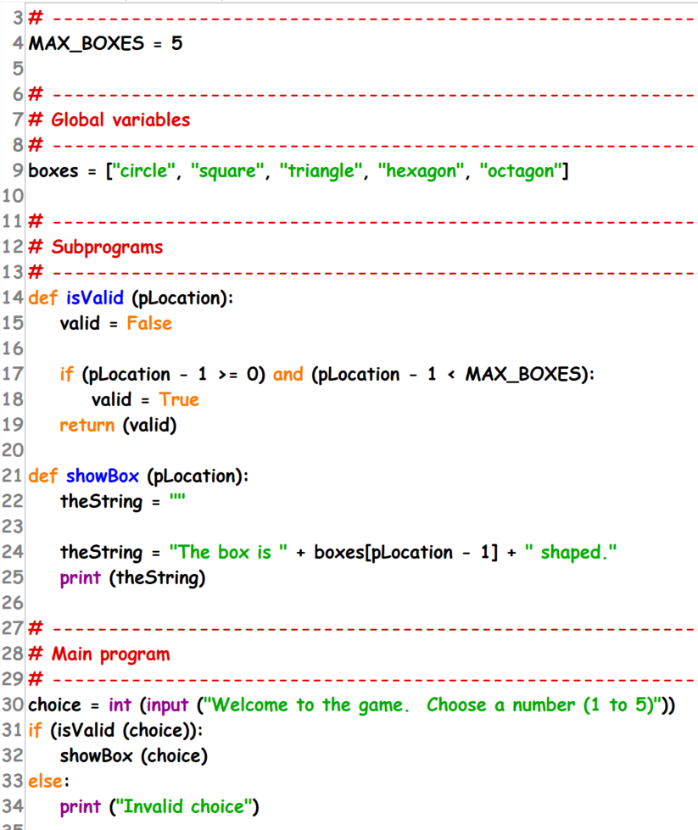
Starter task
Identify in the code:
Name of a parameter
Symbol used to show assignment
Name of a structured data type implemented as a list
Name of a built in subprogram in the provided code
Name of a user defined function
Name of a constant
Name of a local variable

Slide 3
Starter task
Identify:
Name of a parameter
Symbol used to show assignment
Name of a structured data type implemented as a list
Name of a built in subprogram in the provided code
Name of a user defined function
Name of a constant
Name of a local variable

Slide 4

KEY QUESTION
How can we format the output?

Slide 5


String Format
Format output to meet requirements
Format output suitable for the end user.
Notes:
Specification content: 1.2.2 6.3.1 6.3.3 6.6.1

Slide 6
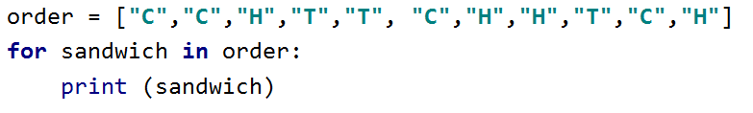
Looping through lists recap
In a previous lesson you learned how to iterate over a list data structure.
This allows you to look at, or interact with each item in the list - one after another.
This program would print each item in the list one at a time.

Slide 7

Activity 1
Open up Activity 1 – predict what you think will happen?
Now have a go at running the code to check your prediction.

Slide 8
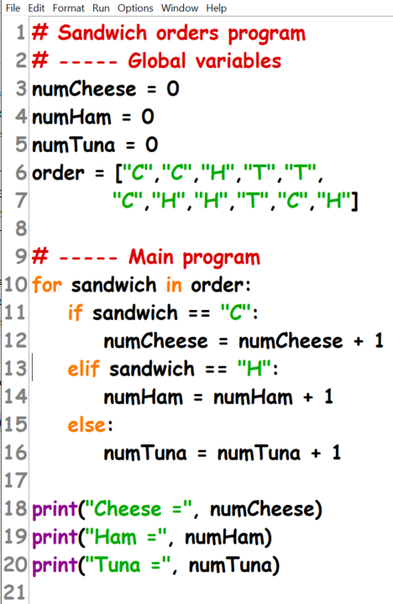
Sandwich order program
This program will count up the orders for sandwich fillings and output the totals so that the right number can be prepared.
The program could be extended to allow new orders to be added.
Notes:
Student Activity 1

Slide 9
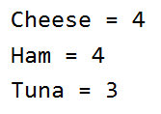
Controlling program output
This is the output of the previous program.
For this small exercise, this is usable. However, if this program was much larger and worked with more data, this output would not be very user-friendly.
When working with data in a text-based computer program, consider how to output the results so they are easy to read.

Slide 10
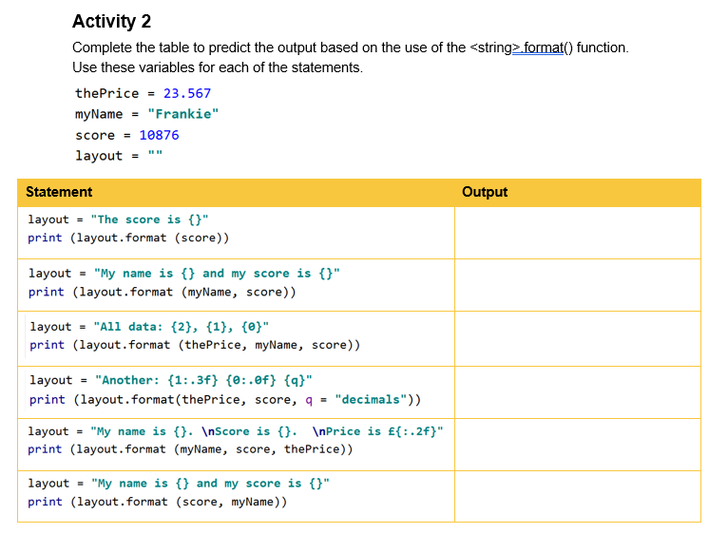
Activity Q2 – have a go at as many of these as you can in your book

Slide 11

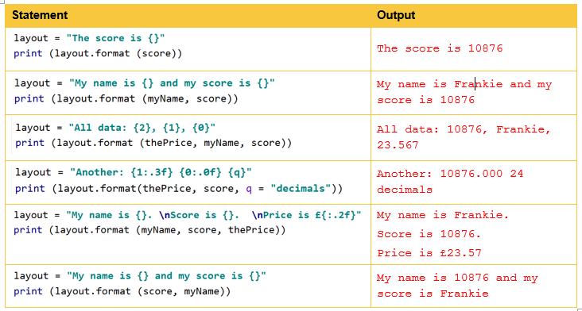
Make sure to correct any mistakes

Slide 12
Columns
The most common way of presenting lots of information for a person to read is in a table.
Tables have rows and columns.
In industry, the standard width of an output is 80 columns wide. This is equivalent to a width of 80 characters.
Programmers can therefore organise the data output from their programs into tables with a maximum width of 80 characters.

Slide 13
<string>.format()
In Python you can use the <string>.format() function to make the string readable when it is output.
Recall that the print() function displays one line of text to the screen (and also starts a new line).
Combined, these two functions can produce rows of output text that are formatted in the layout needed.

Slide 14


Format works by putting placeholders into a string, defined by { }, and calling the <string>.format() function.
Outputs:
Also multiple placeholders:
Outputs:

Slide 15


<string>.format() usage
You can also use an index value.
Predict what the code will output:
You can also add variable names to the items in the format function so that these are used in the placeholder, like so:
Predict what the code will output:

Slide 16


<string>.format() usage
You can also specify the data type of a value, like so:
Predict what the code outputs.
Let’s look closer
at this:
Limit to two decimal places
Convert to float
Selects first item in format
Part of the keyword – means apply format to the item on the left
Notes:
Student Activity 2

Slide 17

Columns
Format can also be used to set field widths.
This adds additional empty characters and is known as padding.
This will enable you to create tables of data in the output.
In Python this looks like
This code creates a column 6 characters wide, using blank spaces to pad the width.
You should plan your output on paper first so that you know how wide to make your columns.
Square paper helps with this exercise.
Notes:
Student Activity 3

Slide 18
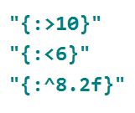
Field alignment
The format function includes some additional tools to help improve the look of your columns.
You can include symbols that indicates the alignment of the content of a column.
> means right justify
< means left justify
^ means centre align

Slide 19
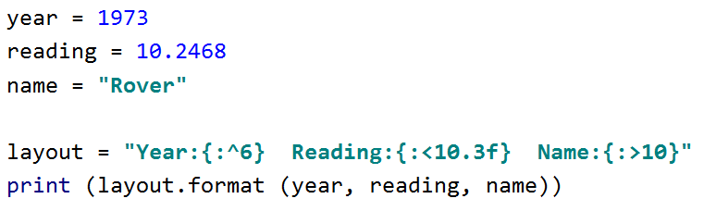
Creating columns
You can combine padding and alignment to create columns.
What will this code layout produce?

Slide 20

Borders
You can also use symbols to produce borders for your tables by simply multiplying a string to print many times.
The code might look like this:
What do you think it will output?
Notes:
Student Activity 4

Slide 21
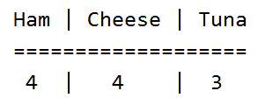
Improved programs
Much of the programming that is done involves improving or maintaining existing code.
In this lesson you have been given some basic code to make fit for purpose.
Making your program and its output user-friendly is always a good idea. It will be expected of you in all the programming you do.
You have improved the way in which the program displays the output by using a table. This makes it much clearer.

Slide 22
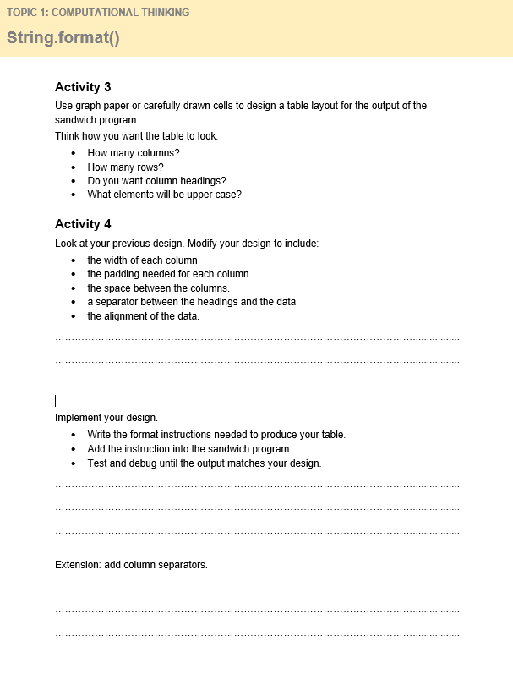
Now edit the code for Q3 & 4

Slide 23
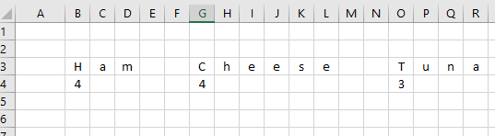
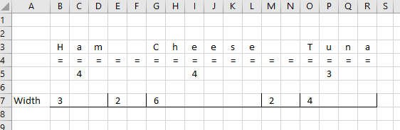
Possible solutions to Q3

Slide 24
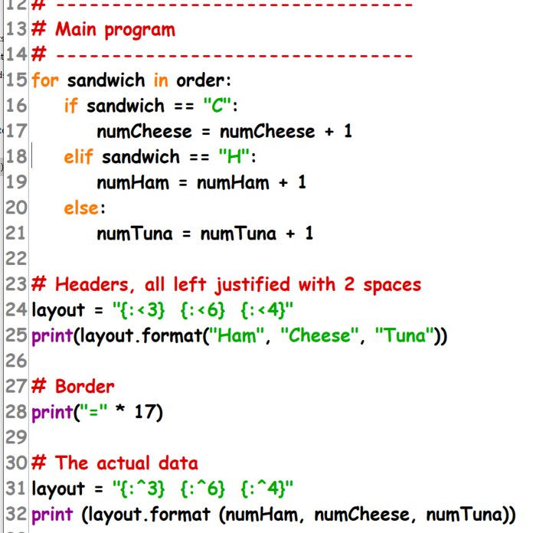
Solution to Q4

Slide 25
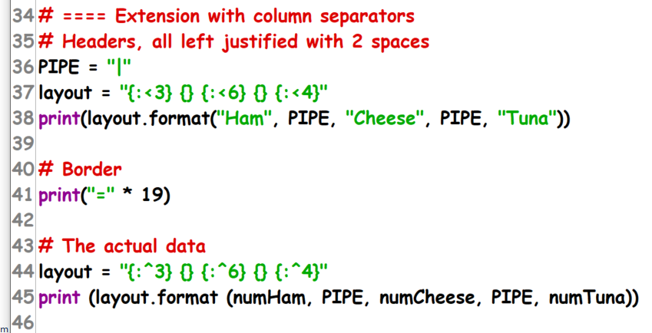
Q4 extension

Slide 26
Plenary
Summarise the main points learned from today’s lesson

Slide 27
Wrap up: you have learned how to…
Format output to meet requirements.
Use <string>.format() to insert variables into placeholders using {}.
Use placeholders that contain a width, padding, and decimal places.
Use alignment in placeholders to automatically move the contents of a column to the correct place within the padding.
Format output suitable for the end user.
Use tables to make output that is more user-friendly that lists of data.
Use format and symbols together to create a table makes the output of a program more user friendly.

